Slide 1
IBM Carbon TreeView
Example 03

Slide 2
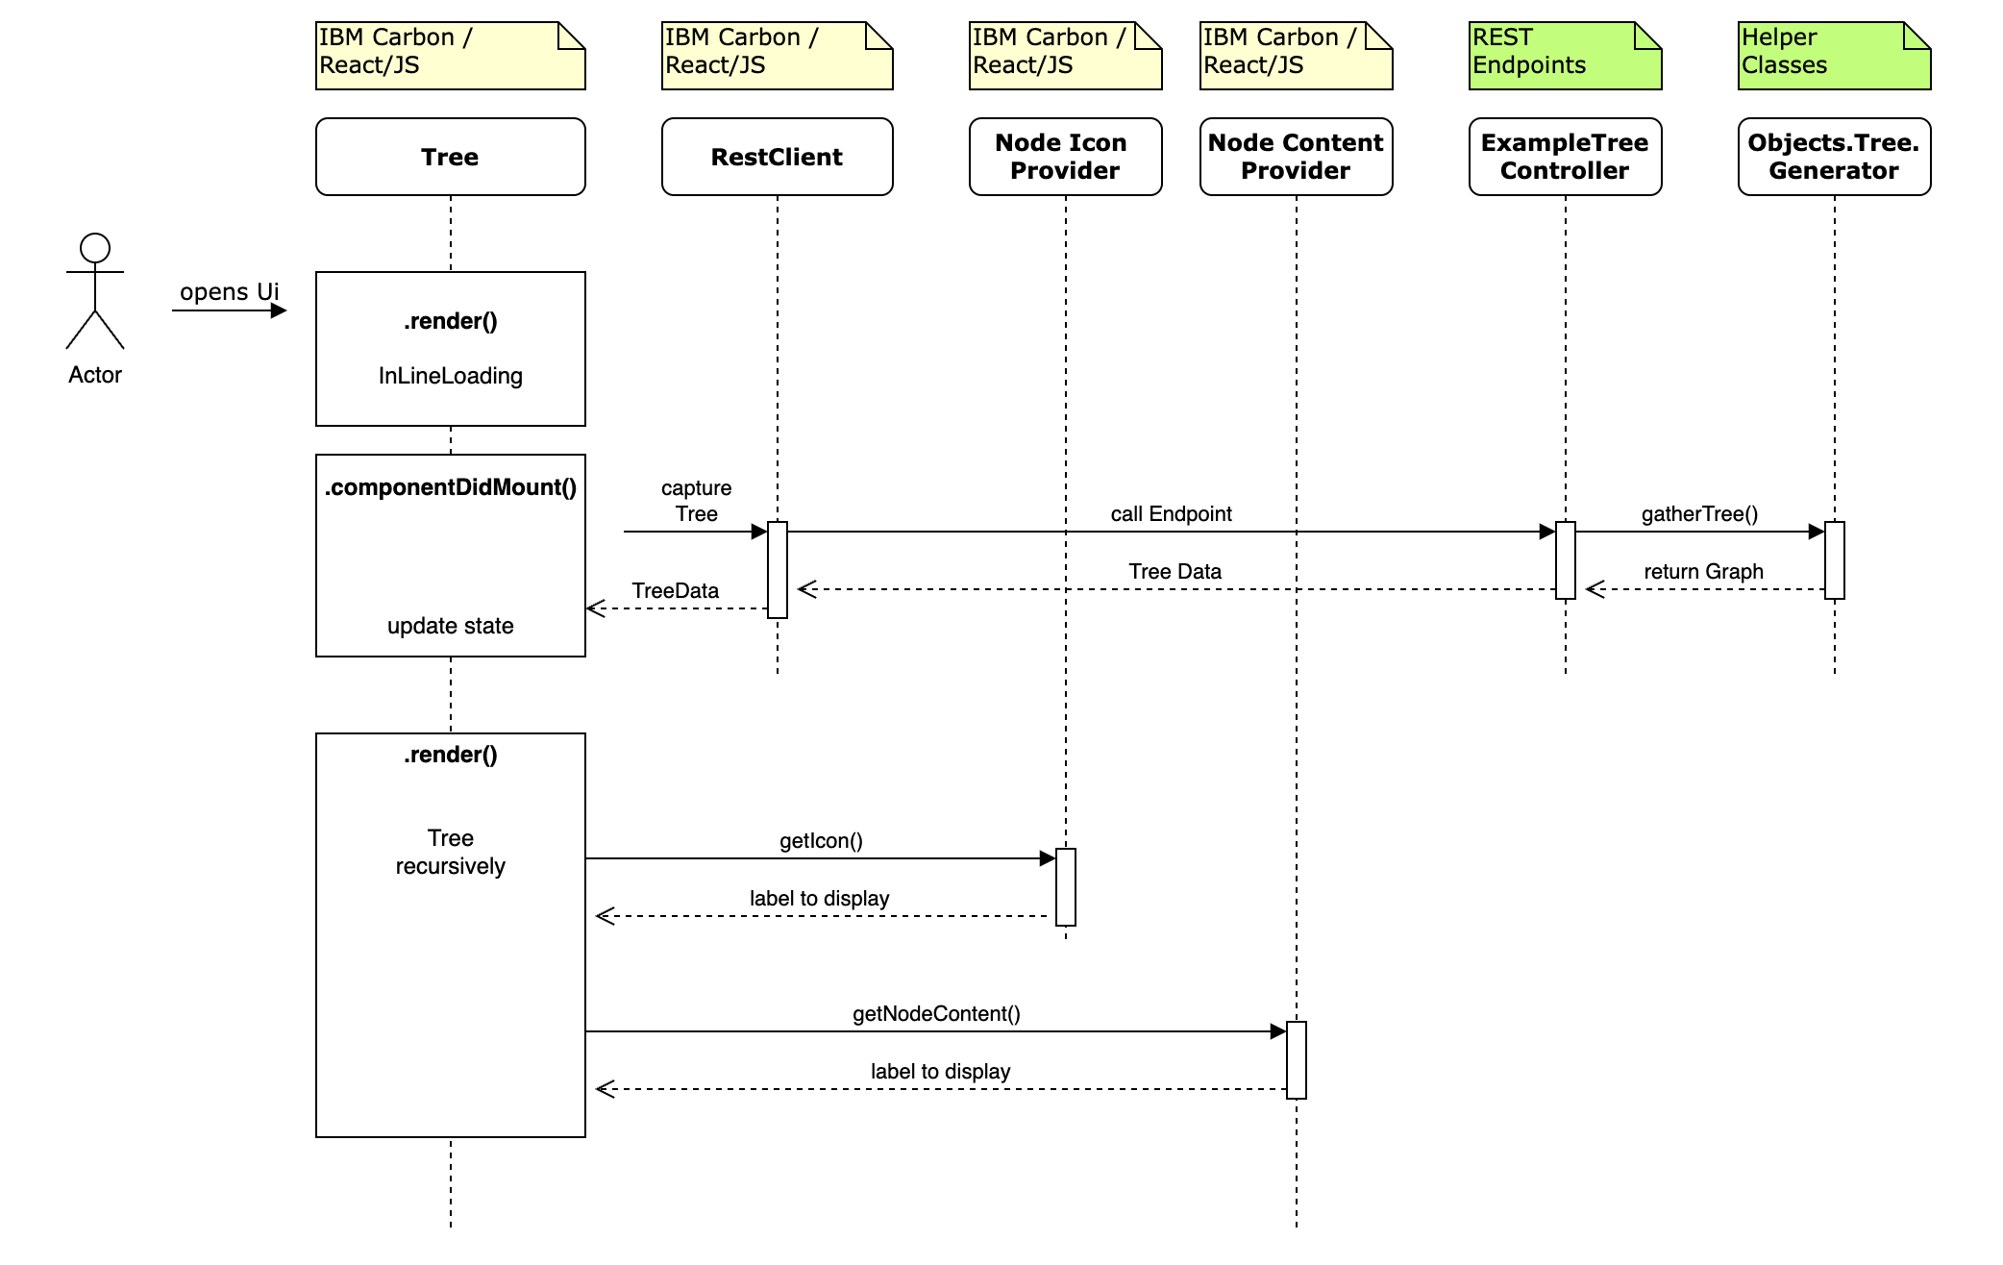
The Basic Sequence Diagram
All Examples follow this Sequence Diagram
… more or less with
Variations

Slide 3
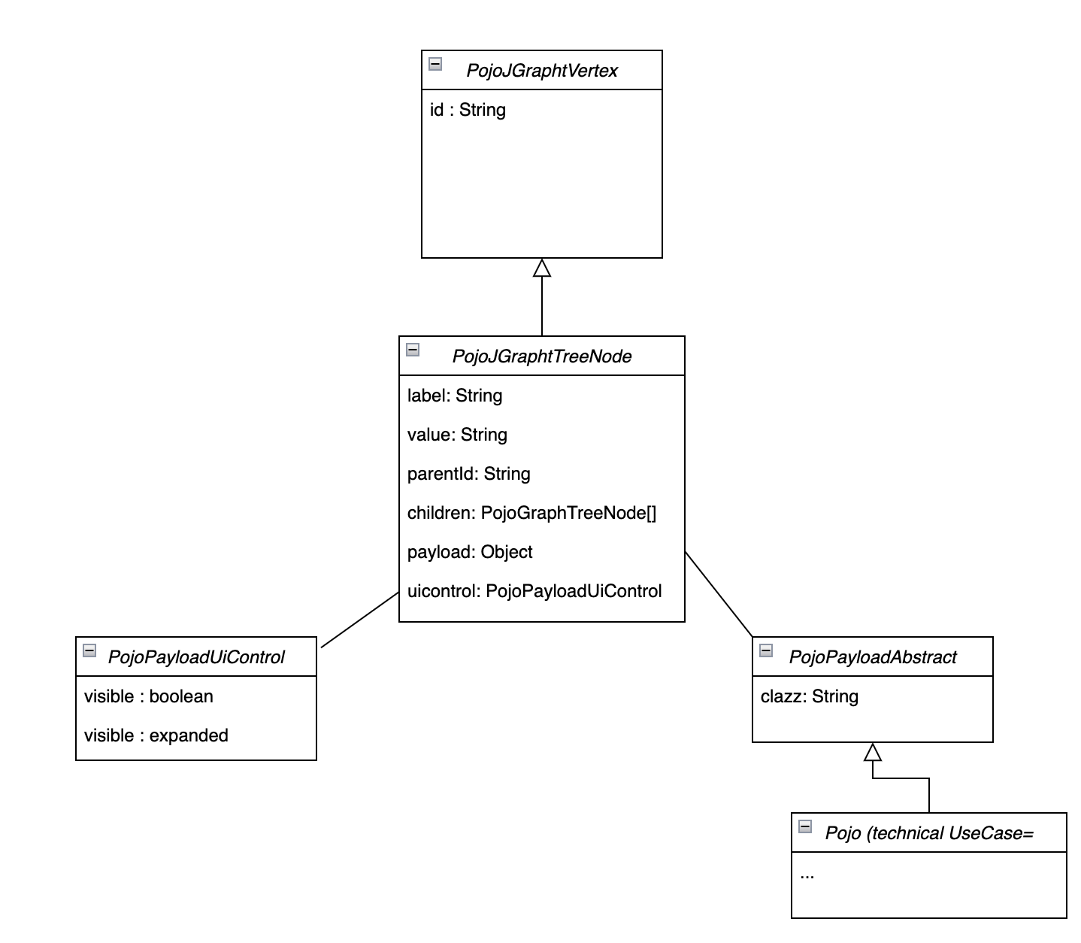
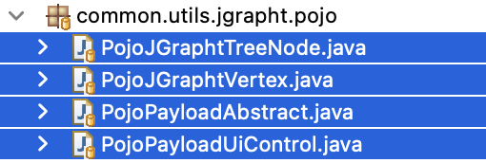
Pojo: Data to deal with and to hand over to IBM Carbon Client
Common
Pojo = Plain Old Java Object
Attributes
Getter & Setter
Technical Use Case
Notes:
Here: Show one of Example Endpoints in Swagger

Slide 4
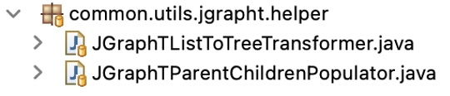

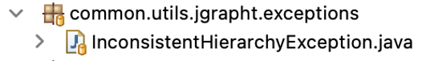

Pojo: Data to deal with and to hand over to IBM Carbon Client
1
1
Performs this Job in Approach 2:
2
REST-Endpoint (Java ) delivers Tree
3
Transformer (Java)
can throw
3
SimpleDirectedGraph
Java reads Source: List
with Hierarchy – Information
2
Supports unique Data Structure in Approach 1
REST-Endpoint (Java ) delivers Tree (direct)
Notes:
Here: Show one of Example Endpoints in Swagger

